Slide 1
Hash Collision Attack

Slide 2
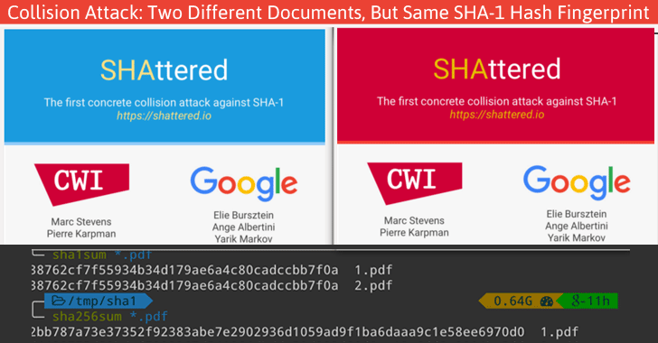

Slide 3
